Slide 1

Reporting and Analyzing Merchandising Activities
4
Chapter
UAA – ACCT 201 Principles of Financial Accounting Dr. Fred Barbee

Slide 2
Service Organizations
Service organizations sell time to earn revenue.
Examples: accounting firms, law firms, and plumbing services.

Slide 3
Service Organizations
Income Statement Service Firm
Fees Earned | $50,000
Operating Expenses | 36,000
Net Income | $14,000

Slide 4
Merchandising Companies
Merchandising companies sell products to earn revenue.
Examples: sporting goods, clothing, and auto parts stores

Slide 5
Merchandising Companies
Income Statement Merchandising Firm
Sales | $150,000
Cost of Goods Sold | 90,000
Gross Profit (Margin) | $60,000
Operating Expenses | 35,000
Net Income | $25,000

Slide 6

Merchandising Activities
Merchandising Companies
Manufacturer
Wholesaler
Retailer
Customer

Slide 7
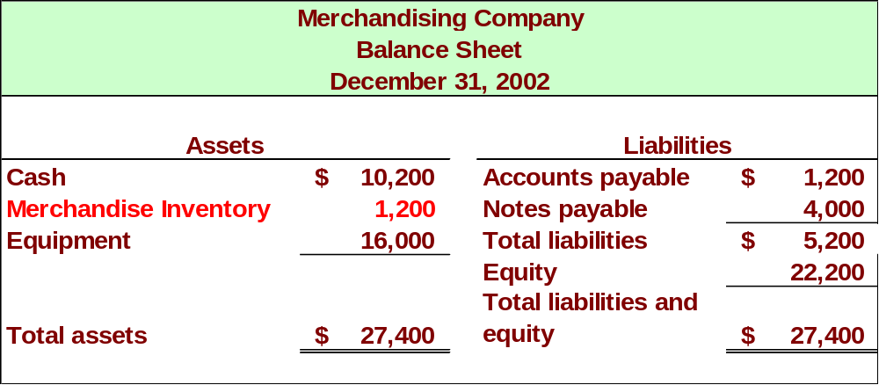
Merchandising Companies

Slide 8
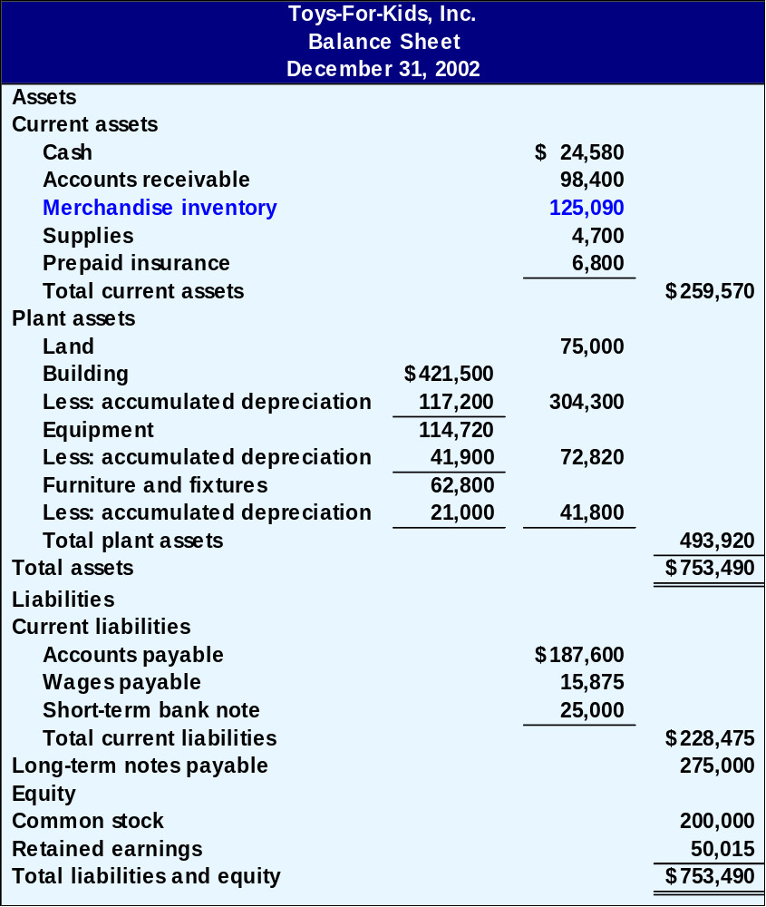
Classified Balance Sheet
ACCT 201 ACCT 201 ACCT 201

Slide 9
Operating Cycle
Begins with the purchase of merchandise and ends with the collection of cash from the sale of merchandise.

Slide 10


Operating Cycle – Cash Sale
Sale
ACCT 201 ACCT 201 ACCT 201
Purchases
Inventory

Slide 11

Operating Cycle – Credit Sale
Sale
Accounts Receivable
Inventory
Collection
Purchases

Slide 12
Inventory Systems
Beginning
inventory
+
Net cost of
purchases
ACCT 201 ACCT 201 ACCT 201
Merchandise
available for sale
Ending Inventory
+
Cost of Goods
Sold

Slide 13

Periodic Inventory Systems
ACCT 201 ACCT 201 ACCT 201

Slide 14
Periodic Inventory System
Physically count inventory, usually at end of accounting period.
No detailed records of the actual inventory are maintained during the accounting period.
Less costly than perpetual inventory method, but provides less information.

Slide 15
Periodic Inventory Method
When Inventory is Purchased
Accts. Payable
Pur. Disc.
xxx
xxx
Purchases
Contra
xxx
Pur. R&A
Inventory
xxx
BI xxx
Contra
The Inventory Account is not updated when inventory is purchased.

Slide 16
Cost of Goods Sold
Component
Amount
Beginning Inventory
$52,800
Net Purchases
126,860
Goods Available for Sale
179,660
Less: Ending Inventory
48,300
Cost of Goods Sold
$131,660

Slide 17
Perpetual Inventory Systems

Slide 18
Perpetual Inventory System
Continuous records are kept of the quantity and, usually, the cost of individual items as they are bought and sold.
More effective for providing information about quantities and ensuring optimal customer service.

Slide 19
Perpetual Inventory Method
Accts. Pay
Pur. Disc.
xxx
xxx
Purchases
When Purchased
xxx
Pur. R&A
Inventory
xxx
xxx
COGS
xxx
xxx
When Sold

Slide 20
Perpetual Inventory System
In a perpetual inventory system, each purchase and sale of merchandise is recorded in an inventory account.
In this way, the inventory records always (perpetually) disclose the amount of inventory on hand the the amount sold.

Slide 21
Merchandise
Purchases
ACCT 201 ACCT 201 ACCT 201

Slide 22
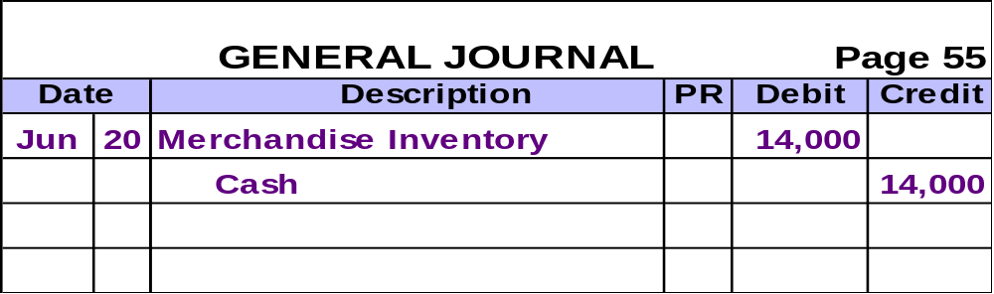
Merchandise Purchases
On June, 20, Melton Company purchased $14,000 of merchandise inventory paying cash.

Slide 23
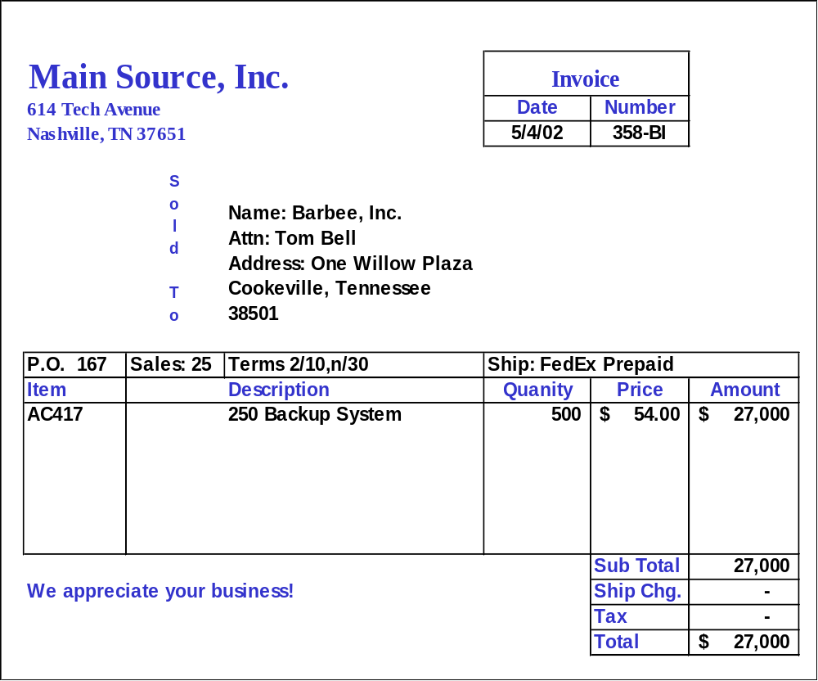
❶
❷
❸
❶Seller ❷Invoice date ❸Purchaser
❹Order number ❺Credit terms
❻Freight terms ❼Goods ❽Invoice amount
❹
❺
❻
❼
❽

Slide 24

Trade Discounts
Used by manufacturers and wholesalers to change selling prices without republishing their catalogs.
Example
JenCo, Inc. offers a 30% trade
discount on orders of 1,000
units or more of their popular
product Racer. Each
Racer has a list price of $5.25.

Slide 25

Purchase Discounts
  A deduction from the invoice price granted to induce early payment of the amount due.
Terms
Time
Due
Discount Period
Credit Period
Full amount
less discount
Full amount due
Purchase or Sale
Exhibit 4-7

Slide 26
Purchase Discounts
2/10,n/30
Number of Days Discount Is Available
Otherwise, Net (or All) Is Due
Discount Percent
Credit
Period

Slide 27
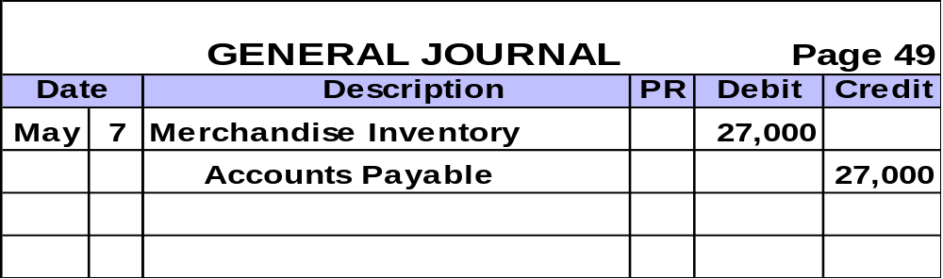
Purchase Discounts
On May 7, Martin, Inc. purchased $27,000 of Merchandise Inventory on account, credit terms are 2/10, n/30.

Slide 28
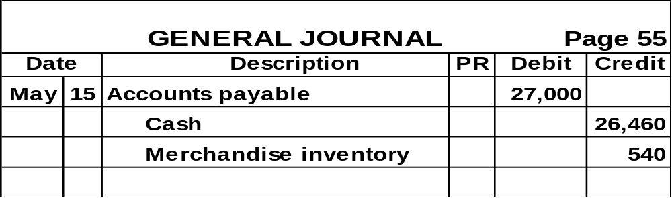
Purchase Discounts
On May 15, Martin, Inc. paid the amount due on the purchase of May 7.
$27,000 × 2% = $540 discount

Slide 29
Purchase Discounts
After we post these entries, the accounts involved look like this:
Merchandise Inventory
Accounts Payable
5/7 27,000
5/15 540
5/15 27,000
5/7 27,000
Bal. 26,460
Bal. 0

Slide 30
Managing Discounts
Annual Rate
If we fail to take a 2/10, n/30 discount, is it really expensive?
365 | / | 20 | X | 2% | = | 36.5%
Days in Year
Percent paid to keep money
Number of additional days before payment

Slide 31


Purchase Returns and Allowances
Purchase Return . . .
  Merchandise returned by the purchaser to the supplier.
Purchase Allowance . . .
  A reduction in the cost of defective merchandise received by a purchaser from a supplier.

Slide 32
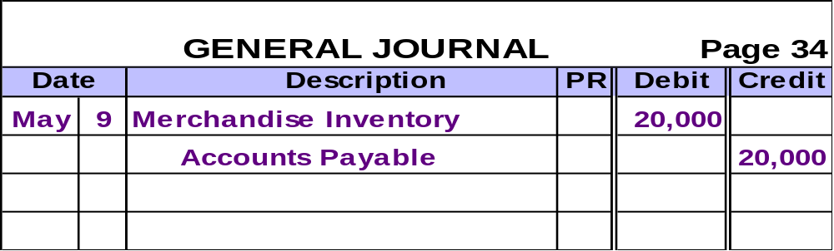
Purchase Returns and Allowances
On May 9, Barbee, Inc. purchased $20,000 of Merchandise Inventory on account, credit terms are 2/10, n/30.

Slide 33
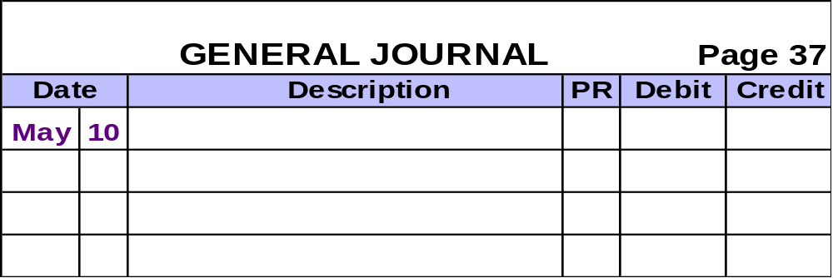
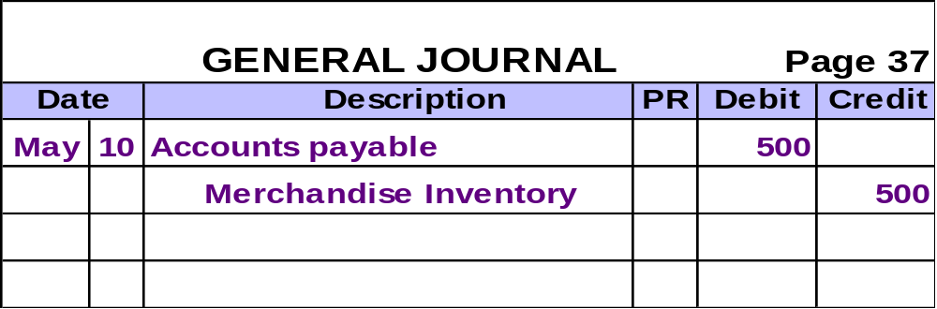
Purchase Returns and Allowances
On May 10, Barbee, Inc. returned $500 of defective merchandise to the supplier.

Slide 34

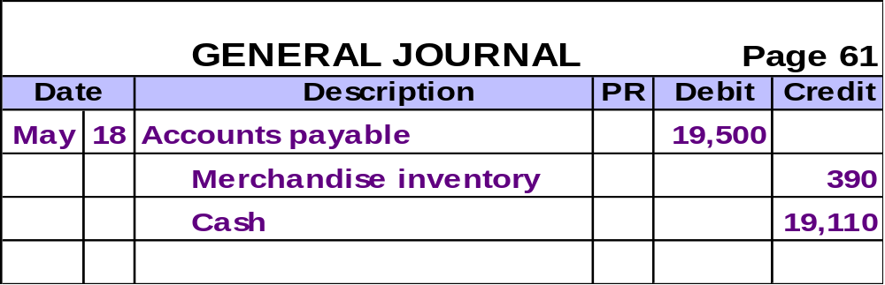

Purchase Returns and Allowances
On May 18, Barbee, Inc. paid the amount owed for the May 9 purchase.

Slide 35

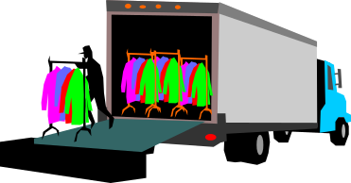
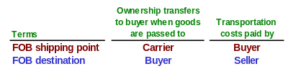
Transportation Costs
Seller
Buyer
FOB shipping point
(buyer pays)
Merchandise
FOB destination
(seller pays)

Slide 36
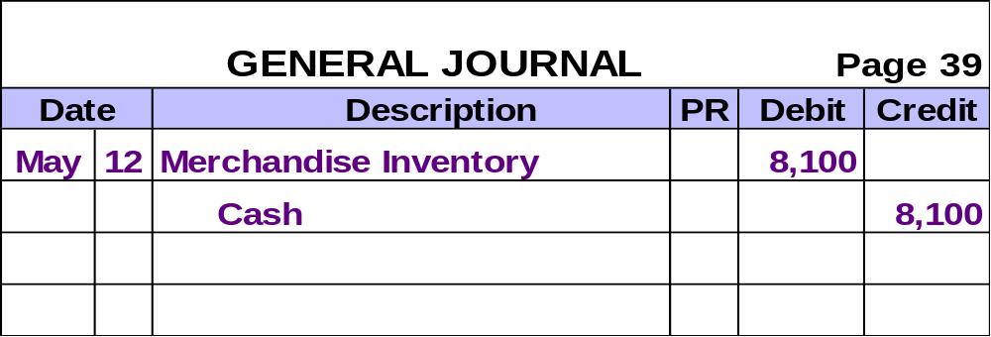
Transportation Costs
On May 12, Barbee, Inc. purchased $8,000 of Merchandise for cash and also paid $100 transportation costs.

Slide 37
On July 6, 2002 Seller Co. sold $7,500 of merchandise to Buyer Co.; terms of 2/10,n/30. The shipping terms were FOB shipping point. The shipping cost was $100. Which of the following will be part of Buyer’s July 6 journal entry?
a. Credit Sales $7,500
b. Credit Purchase Discounts $150
c. Debit Merchandise Inventory $100
d. Debit Accounts Payable $7,450
FOB shipping point indicates the buyer ultimately pays the freight. This is recorded with a debit to Merchandise Inventory.

Slide 38
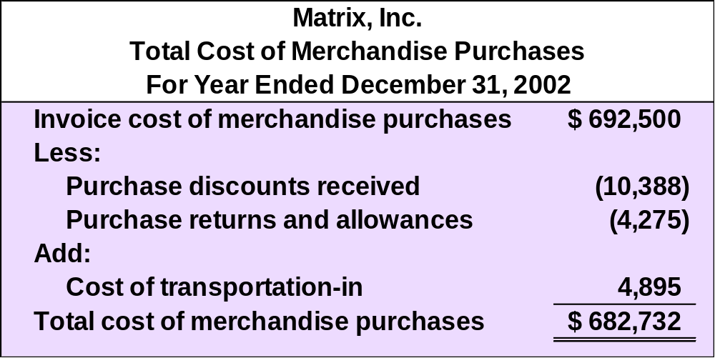
Recording Purchases Information

Slide 39
Merchandise
Sales
ACCT 201 ACCT 201 ACCT 201

Slide 40
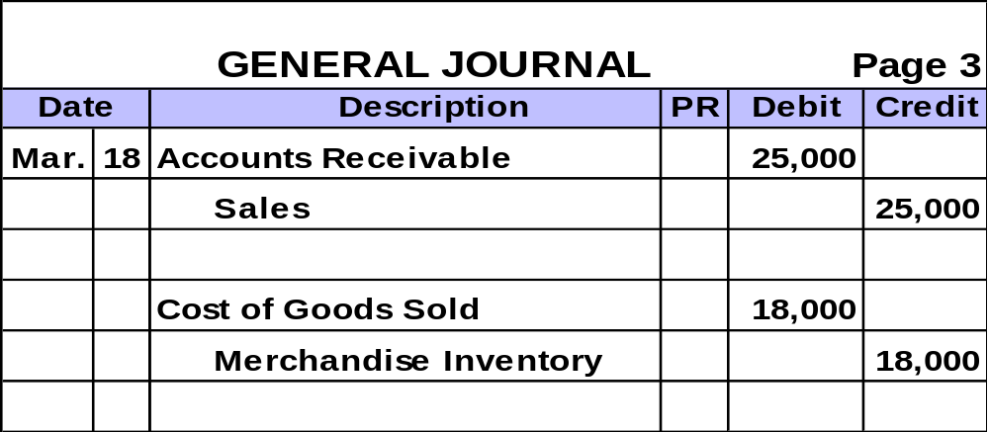
Sales Transactions
  On March 18, TwoCom sold $25,000 of merchandise on account. The merchandise was carried in inventory at a cost of $18,000.
ACCT 201 ACCT 201 ACCT 201

Slide 41
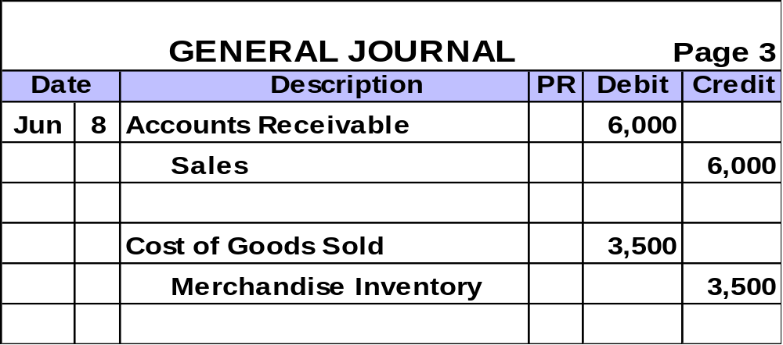
Sales Discounts
  On June 8, Borey Co. sold merchandise costing $3,500 for $6,000 on account. Credit terms were 2/10, n/30.
ACCT 201 ACCT 201 ACCT 201

Slide 42
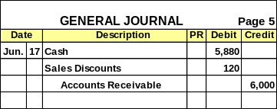
Sales Discounts
  On June 17, Borey Co. received a check for $5,880 in full payment of the June 8 sale.
ACCT 201 ACCT 201 ACCT 201

Slide 43
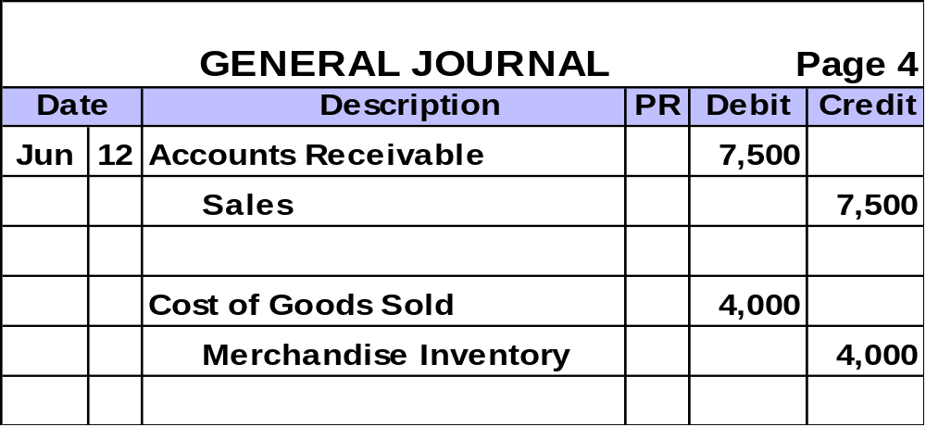

Sales Returns and Allowances
  On June 12, Borey Co. sold merchandise costing $4,000 for $7,500 on account The credit terms were 2/10, n/30.
ACCT 201 ACCT 201 ACCT 201

Slide 44
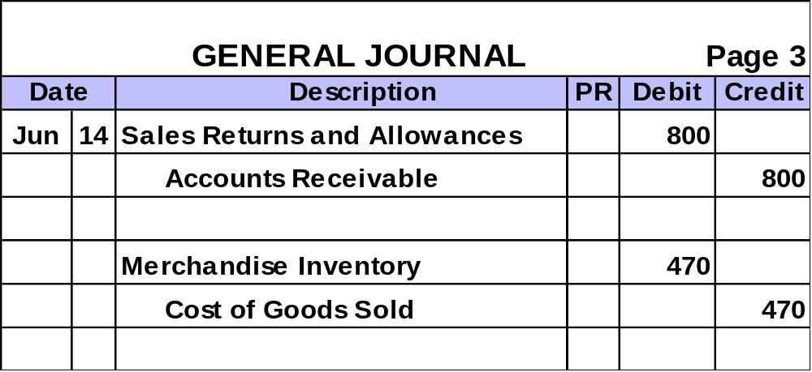
Sales Returns and Allowances
  On June 14, merchandise with a sales price of $800 and a cost of $470 was returned to Borey. The return is related to the June 12 sale.
ACCT 201 ACCT 201 ACCT 201

Slide 45
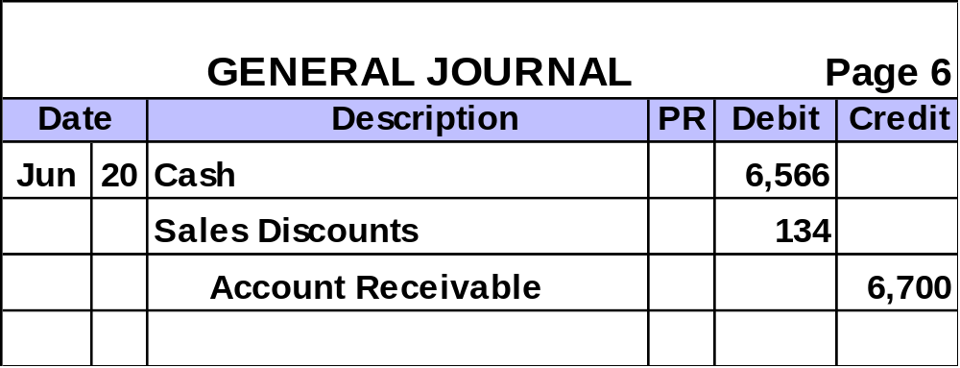

Sales Returns and Allowances
  On June 20, Borey received the amount owed to it from the sale of June 12.
ACCT 201 ACCT 201 ACCT 201

Slide 46
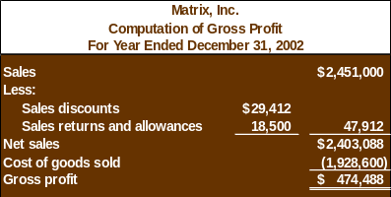
Recording Sales Information
Exh.
6-11
Sales discounts and returns
and allowances are
Contra Revenue accounts.

